Slide 1
Garments
Management System
Sequence and State Chart Diagram
1405072
1405075
1405079
1405086
1405087
Student ID:

Slide 2
Sequence Diagrams

Slide 3
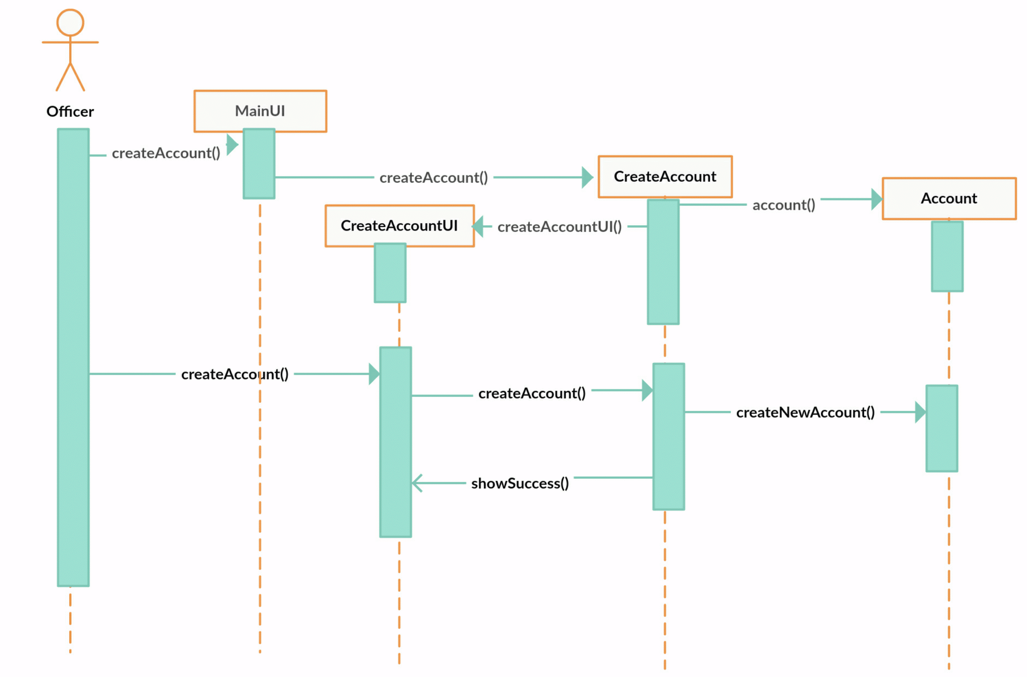
Sequence Diagram for CreateAccount

Slide 4
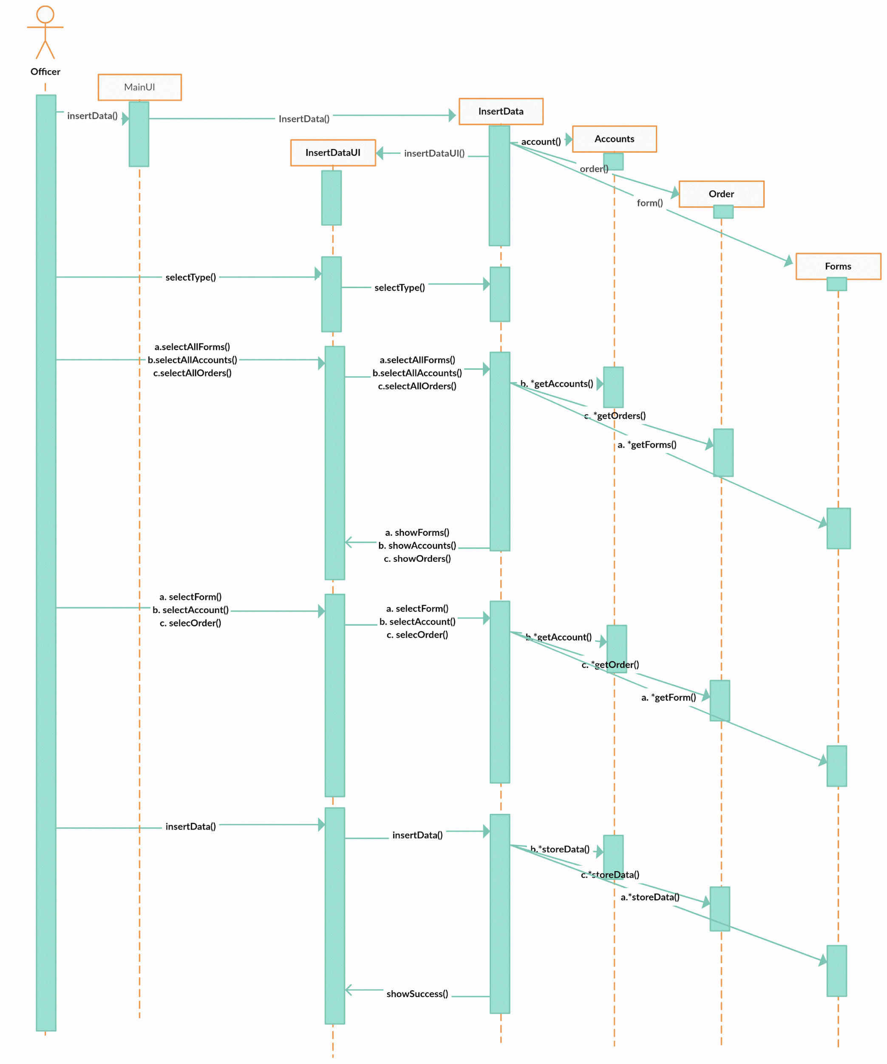
Sequence Diagram for InsertData

Slide 5
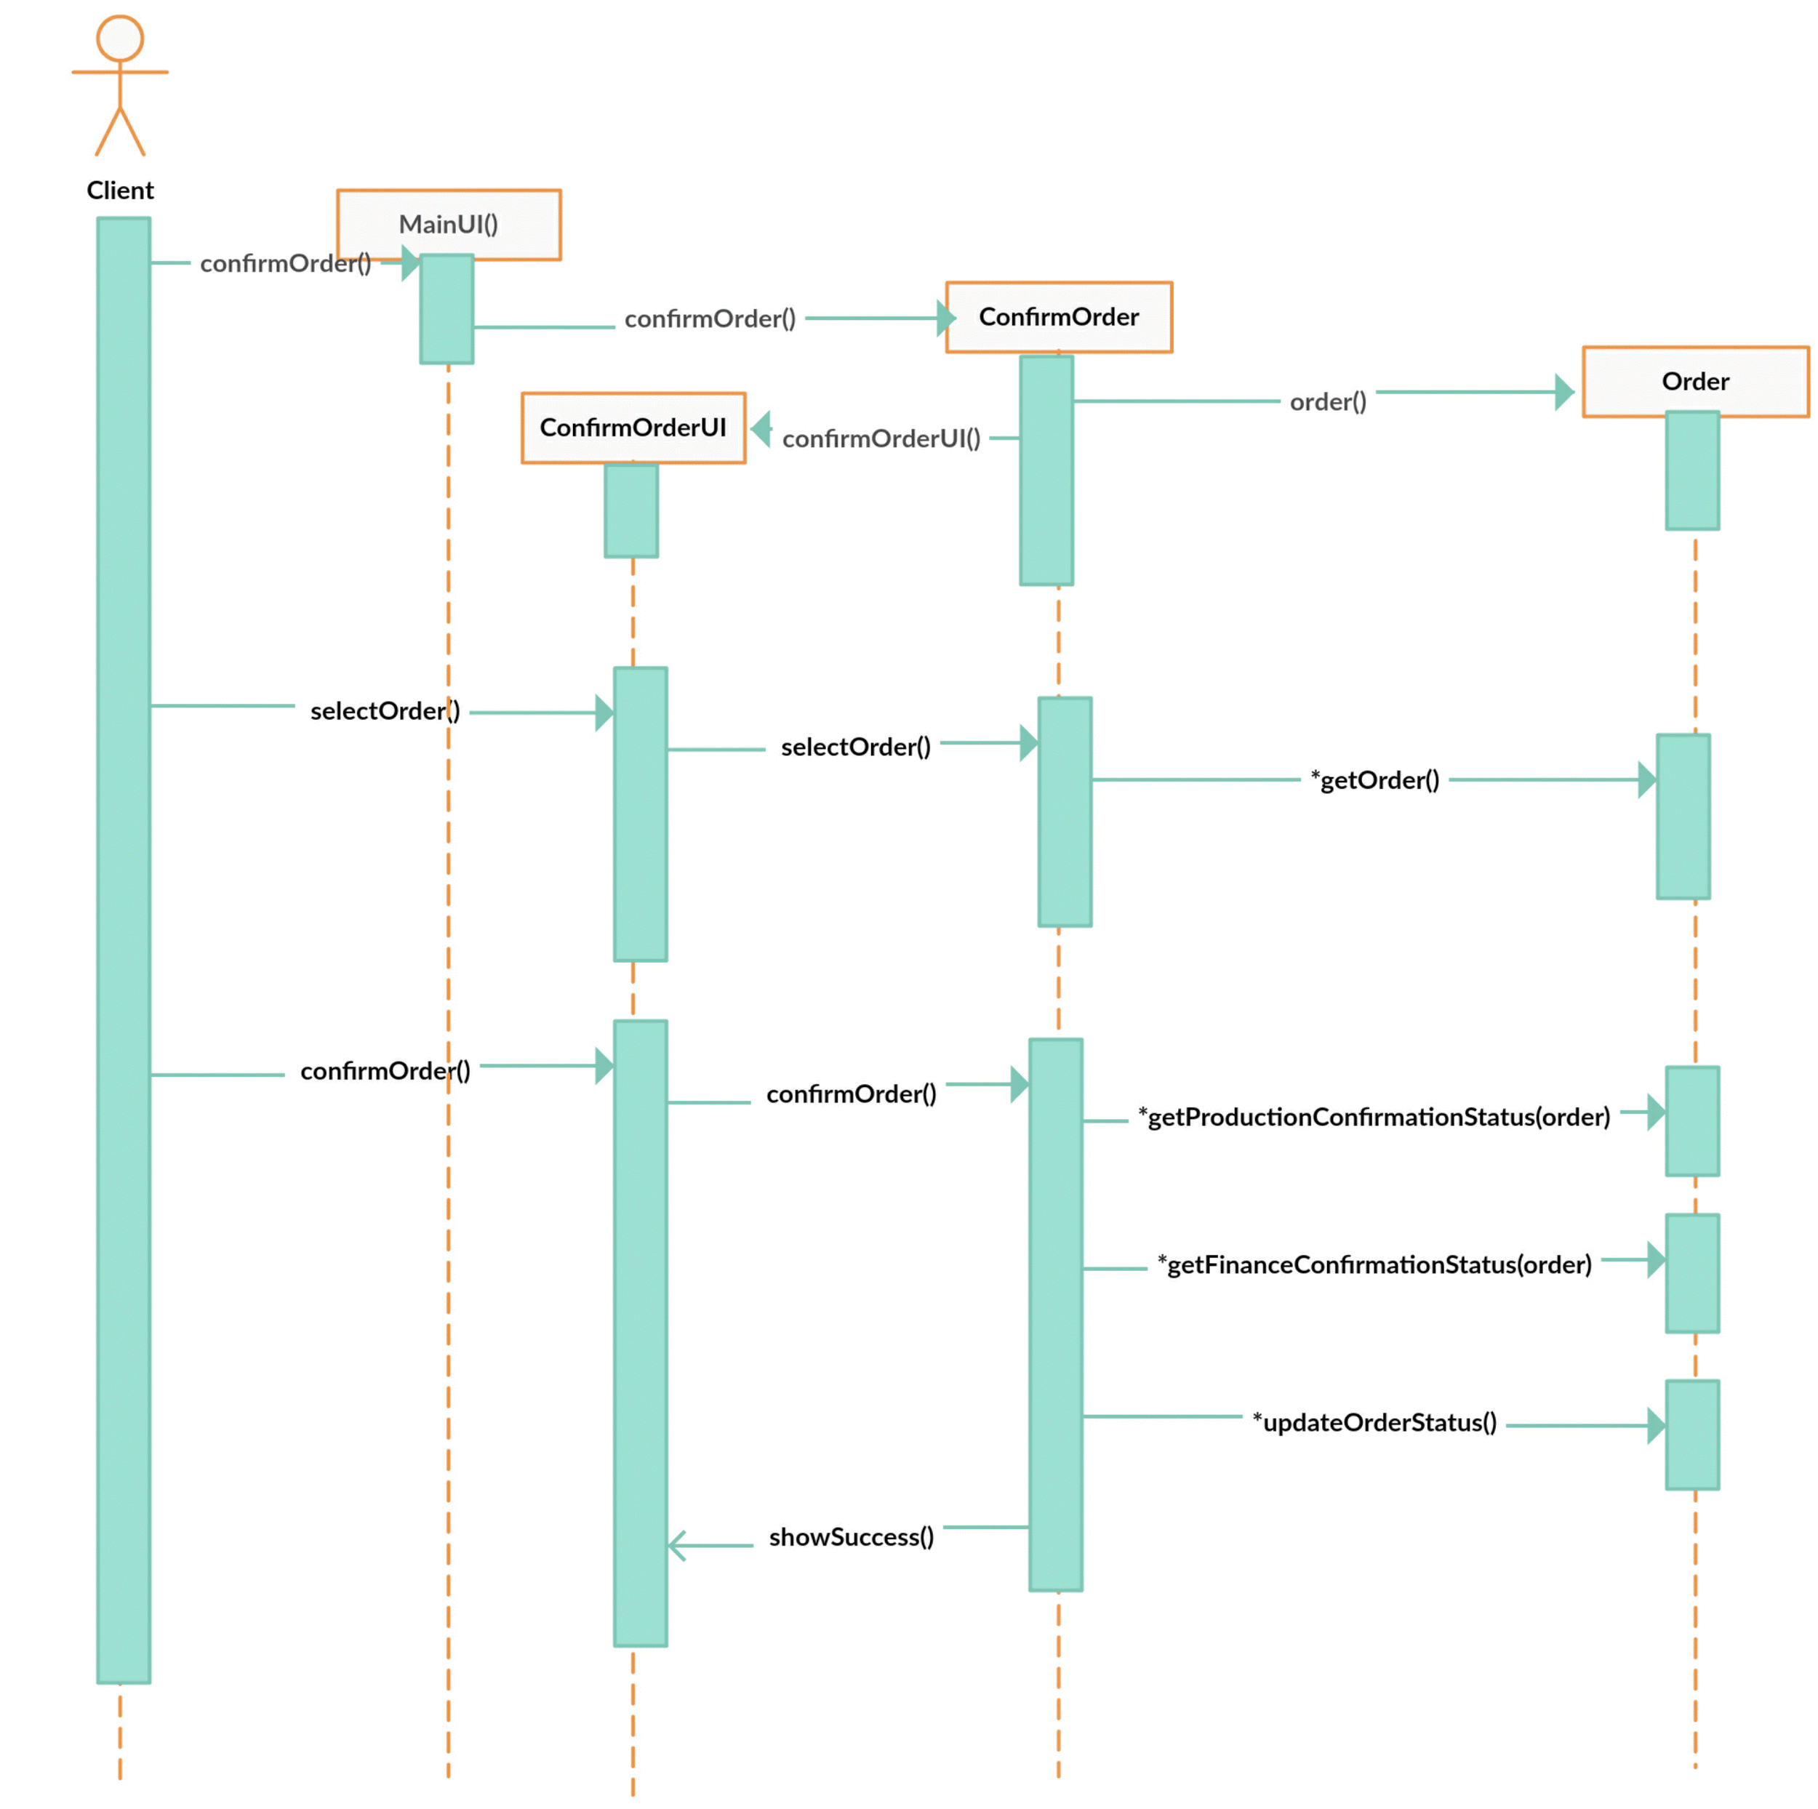
Sequence Diagram for ConfirmOrder

Slide 6
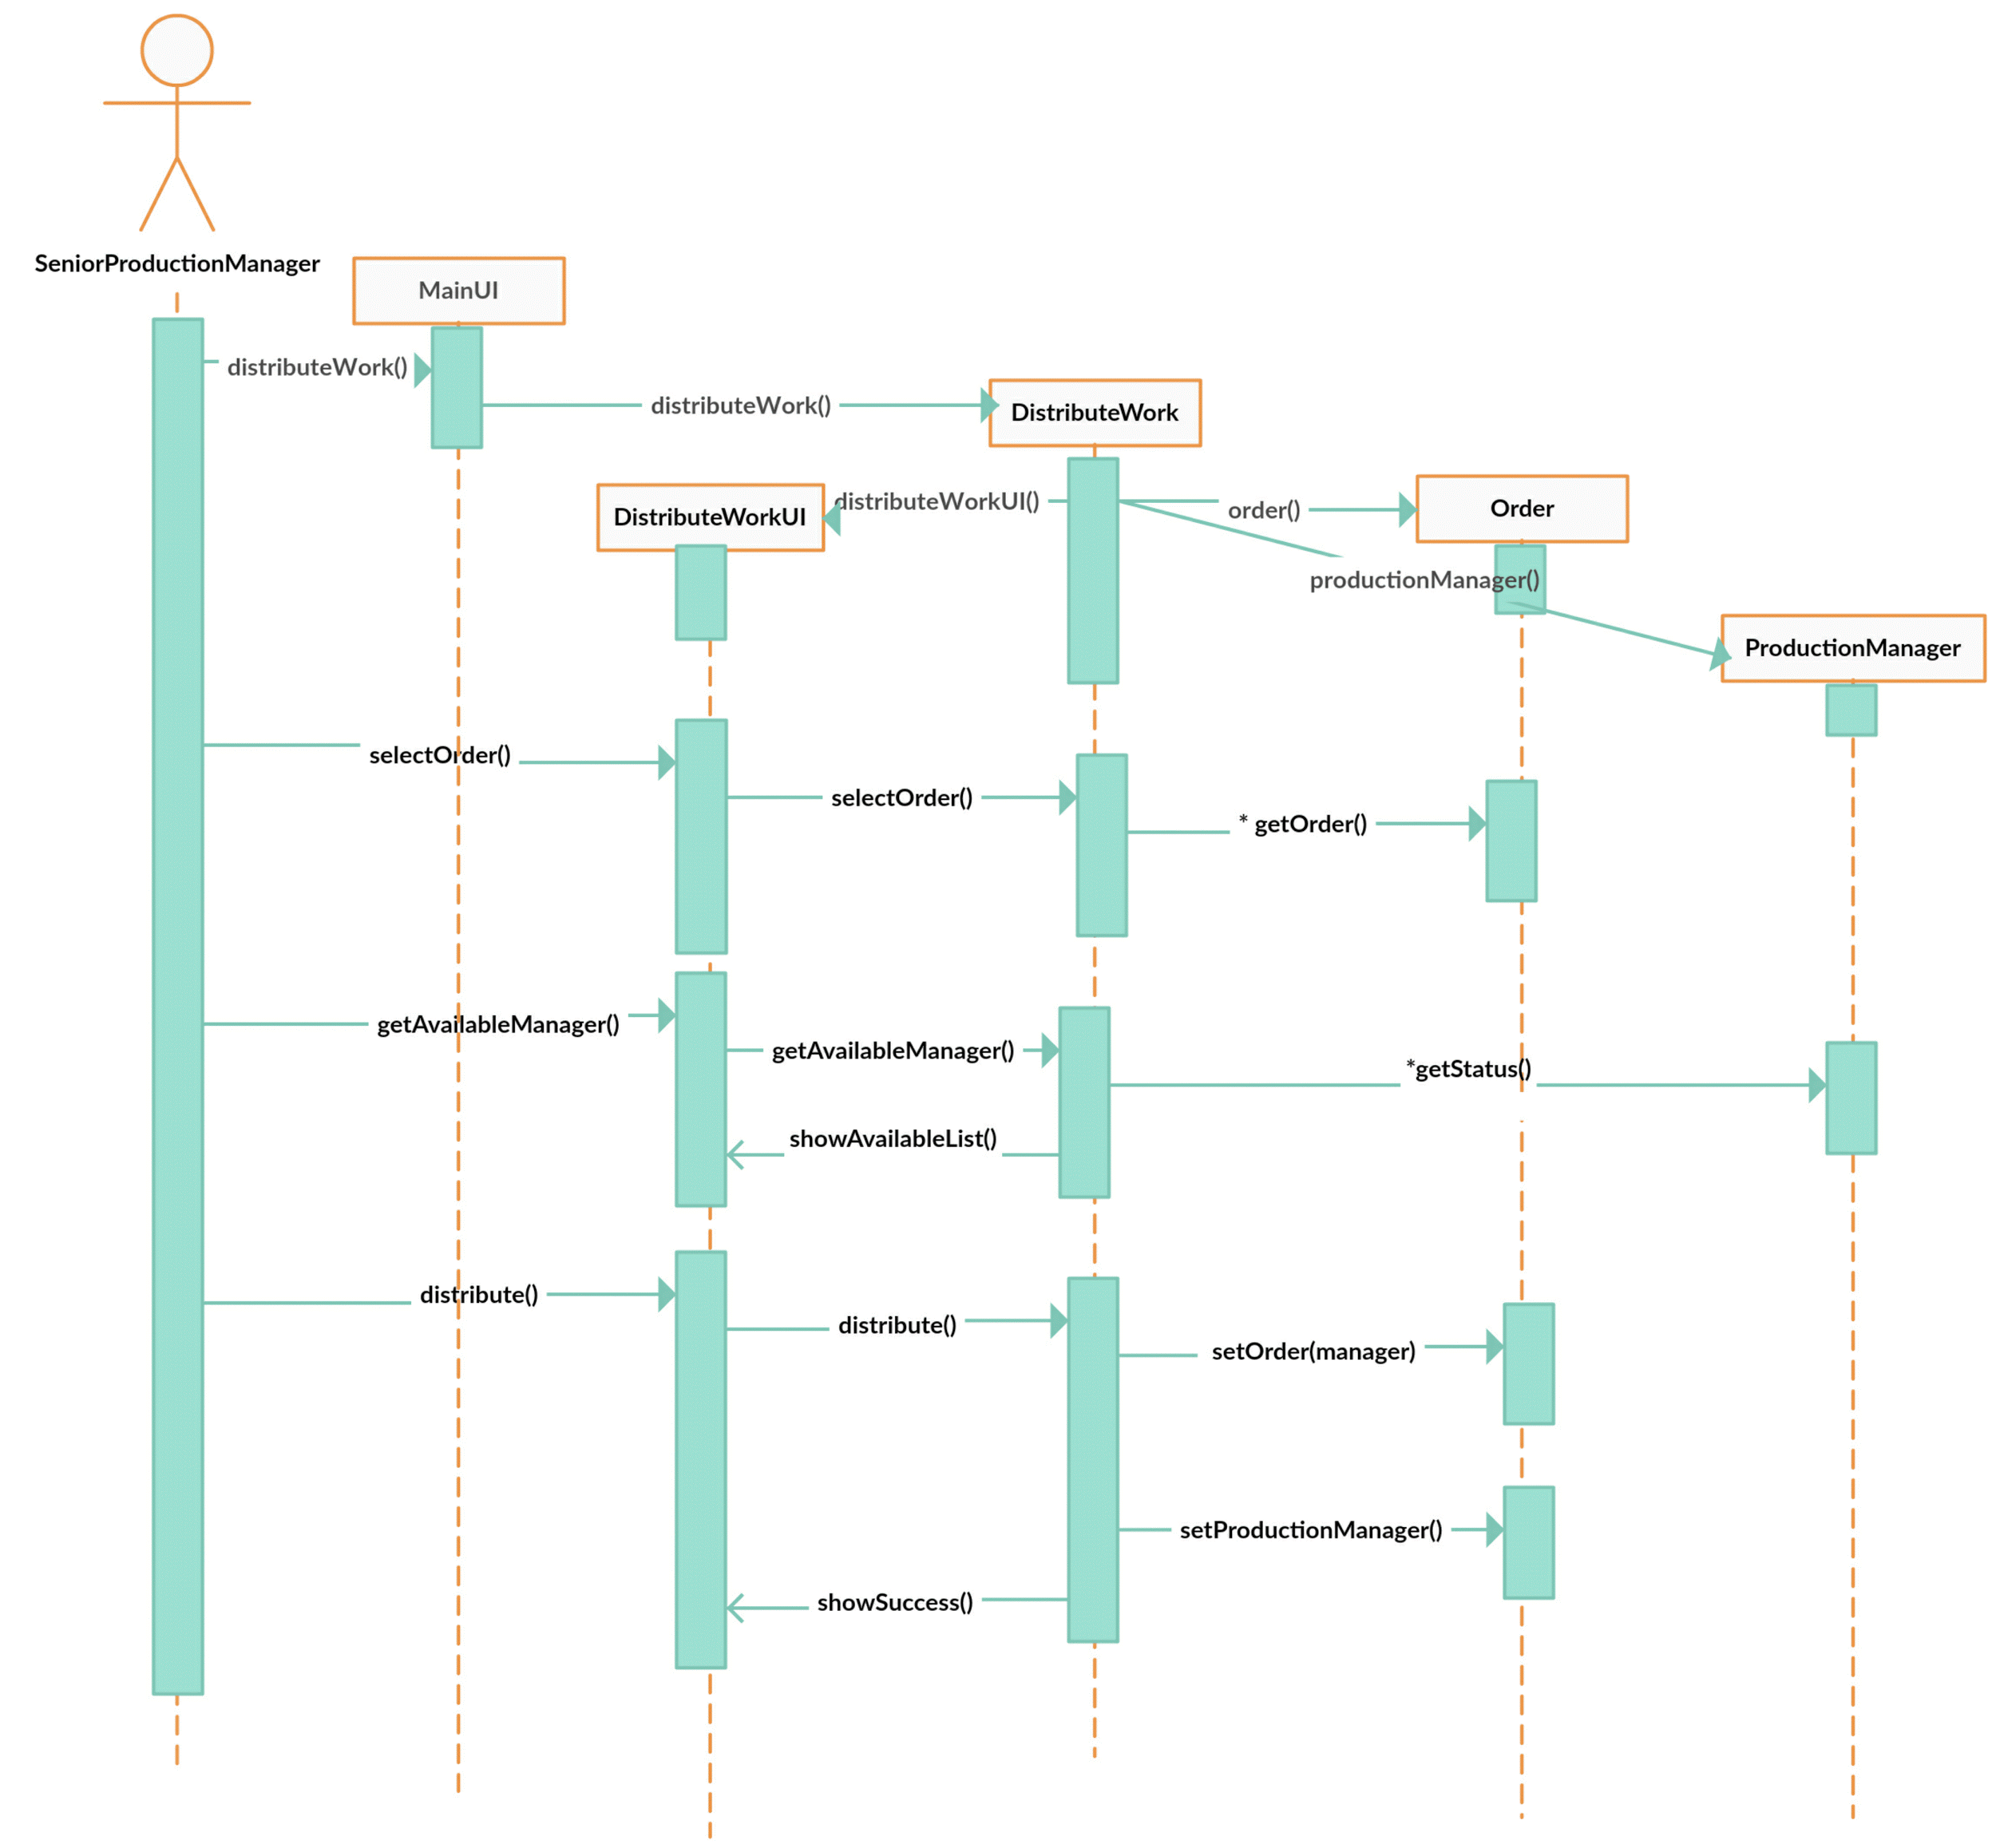
Sequence Diagram for DistributeWork

Slide 7
State Chart Diagrams

Slide 8
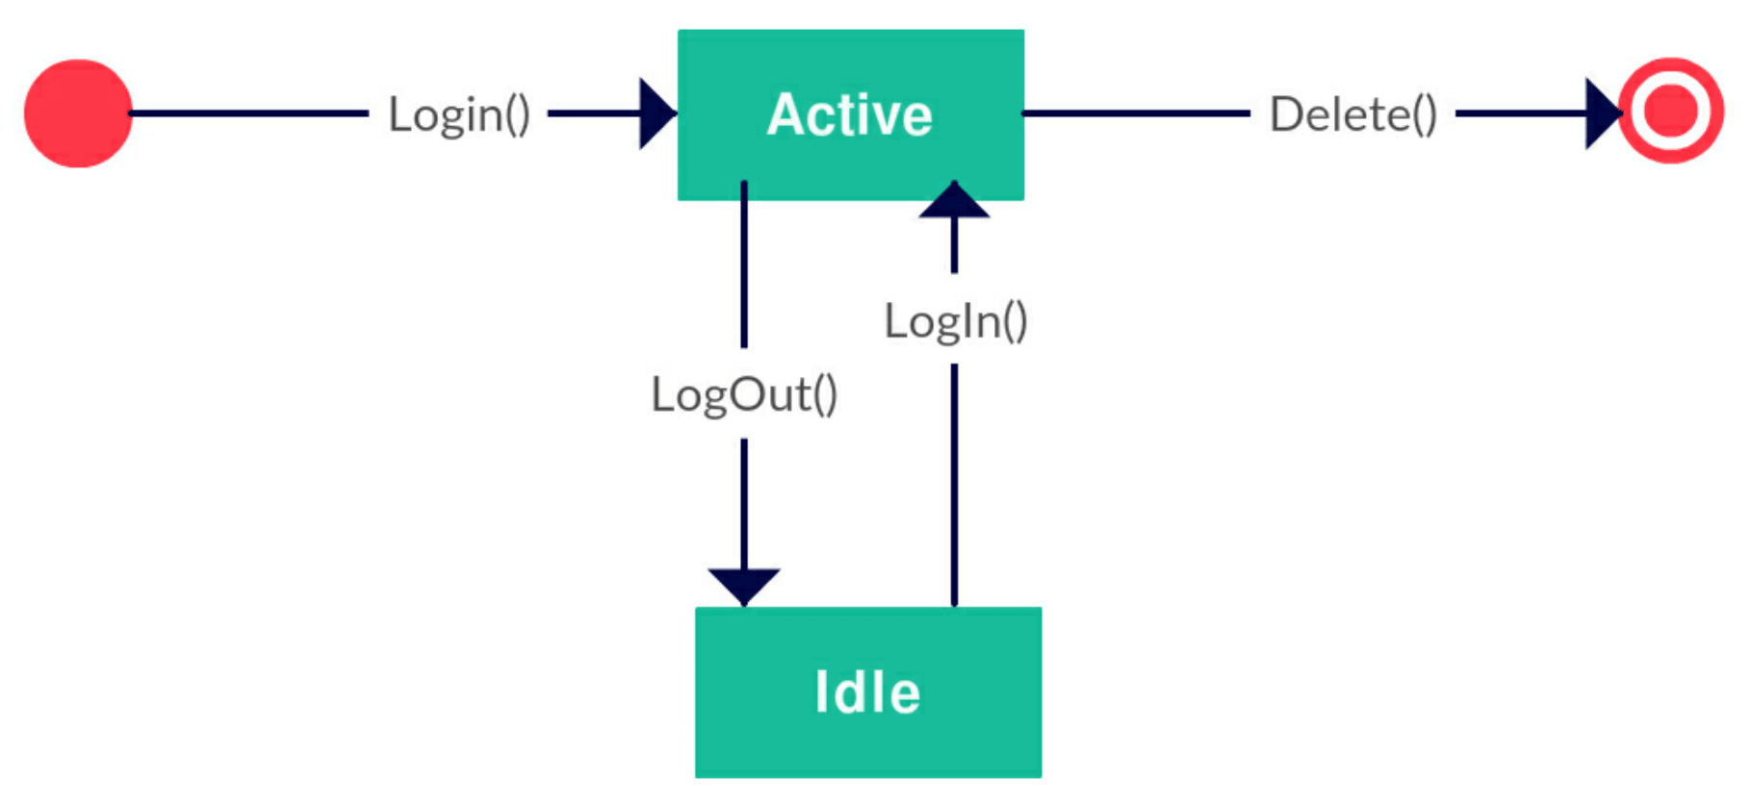
State Diagram for Officer Class

Slide 9
State Diagram for Board of Directors Class

Slide 10
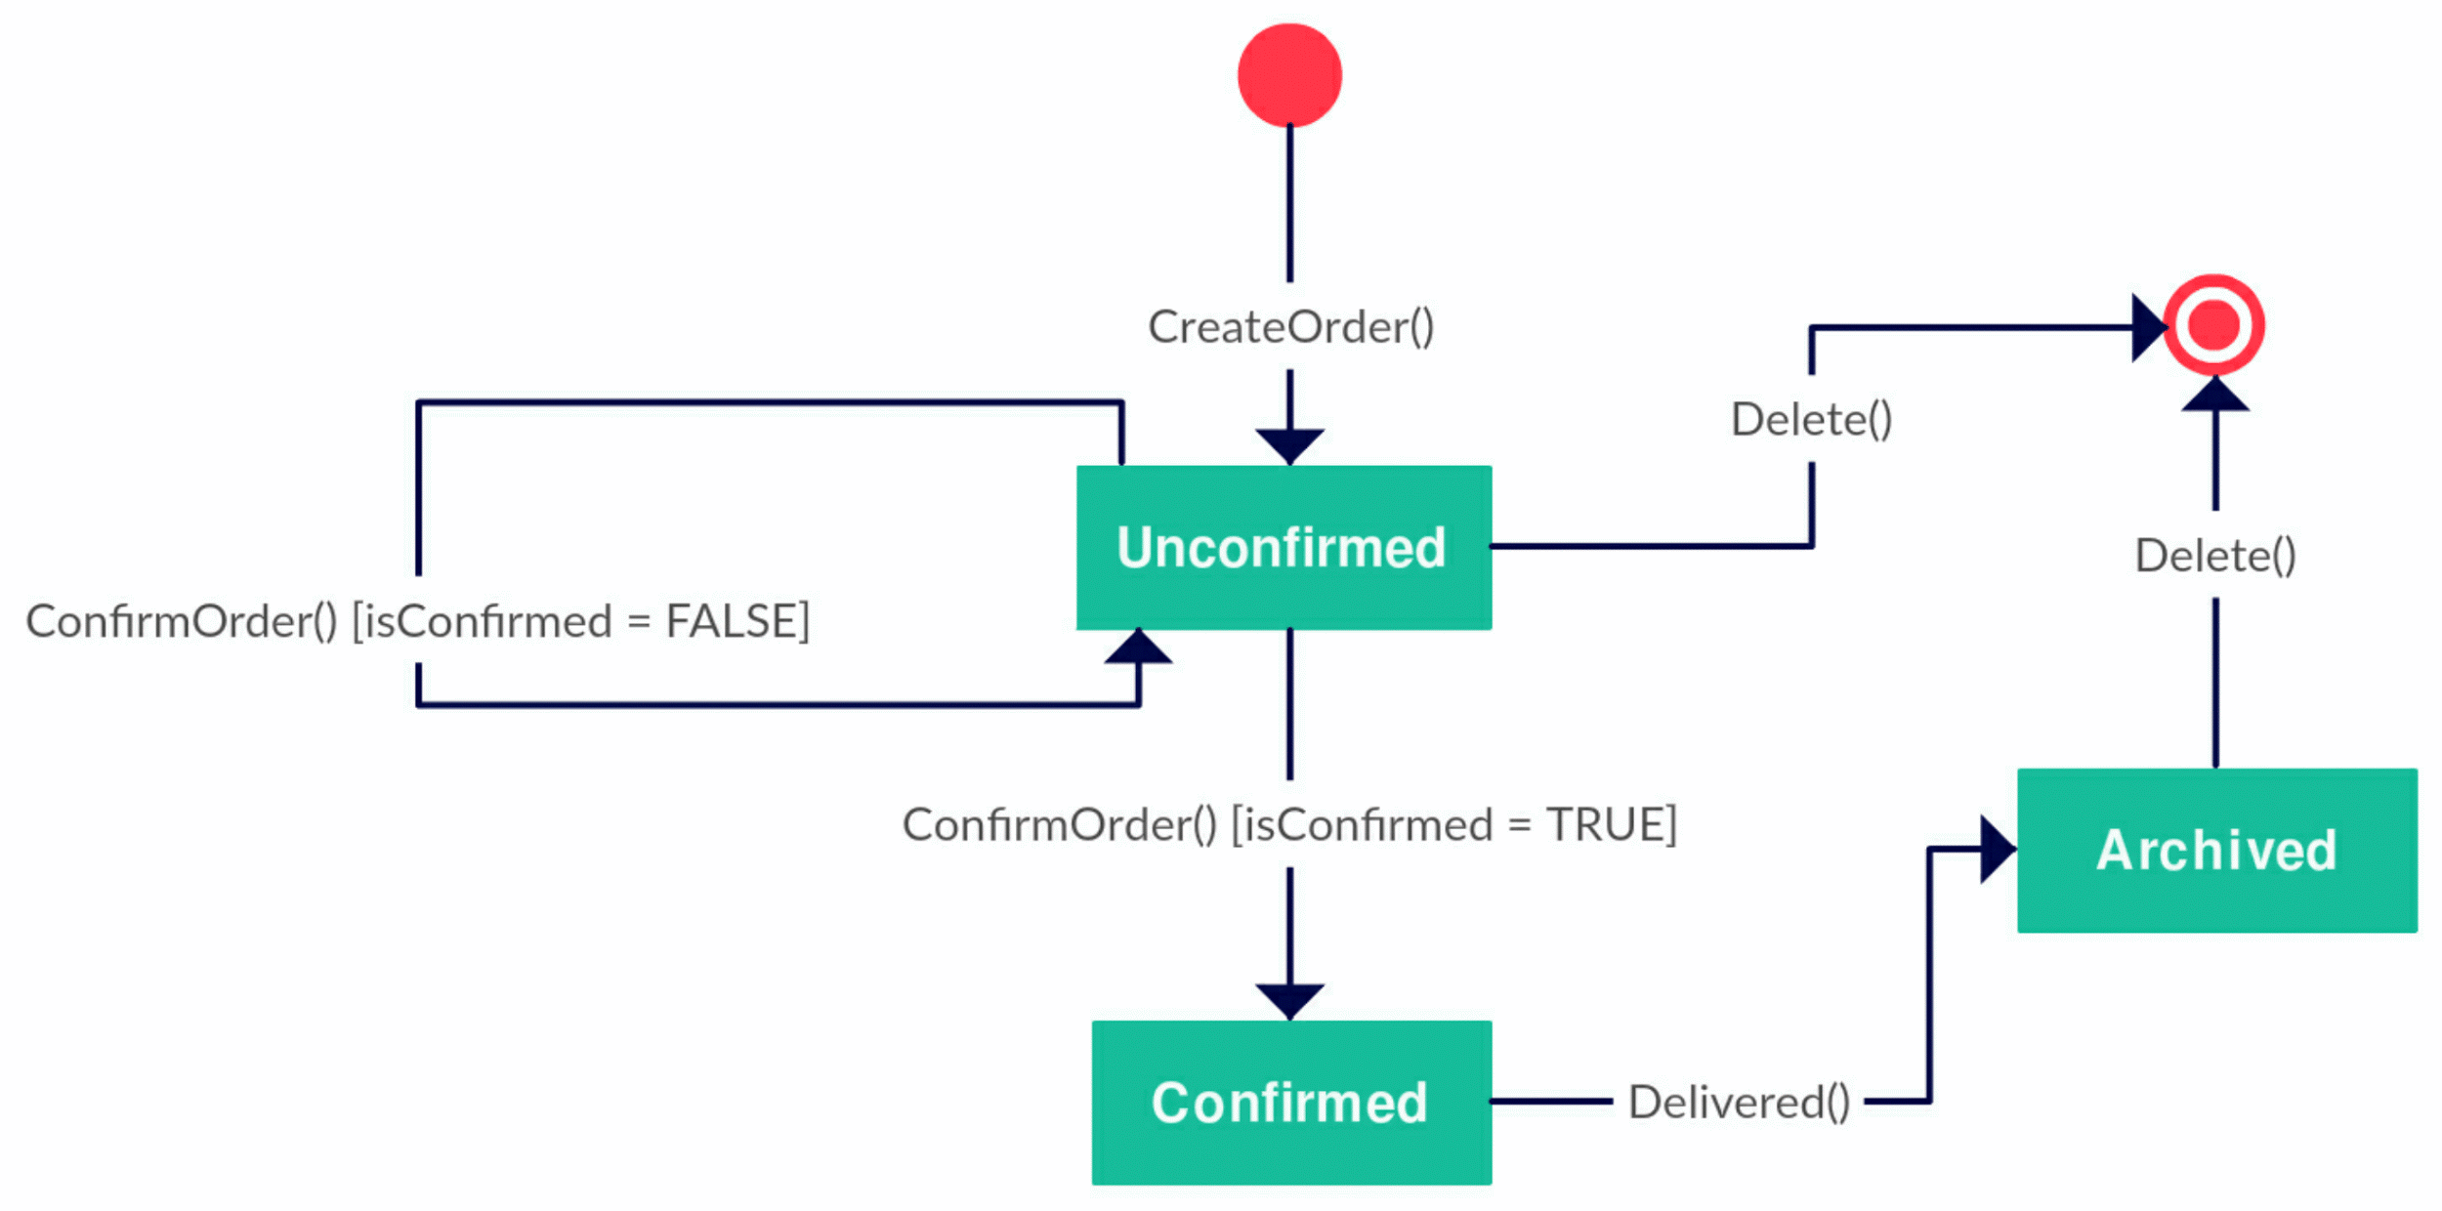
State Diagram for Order Class

Slide 11
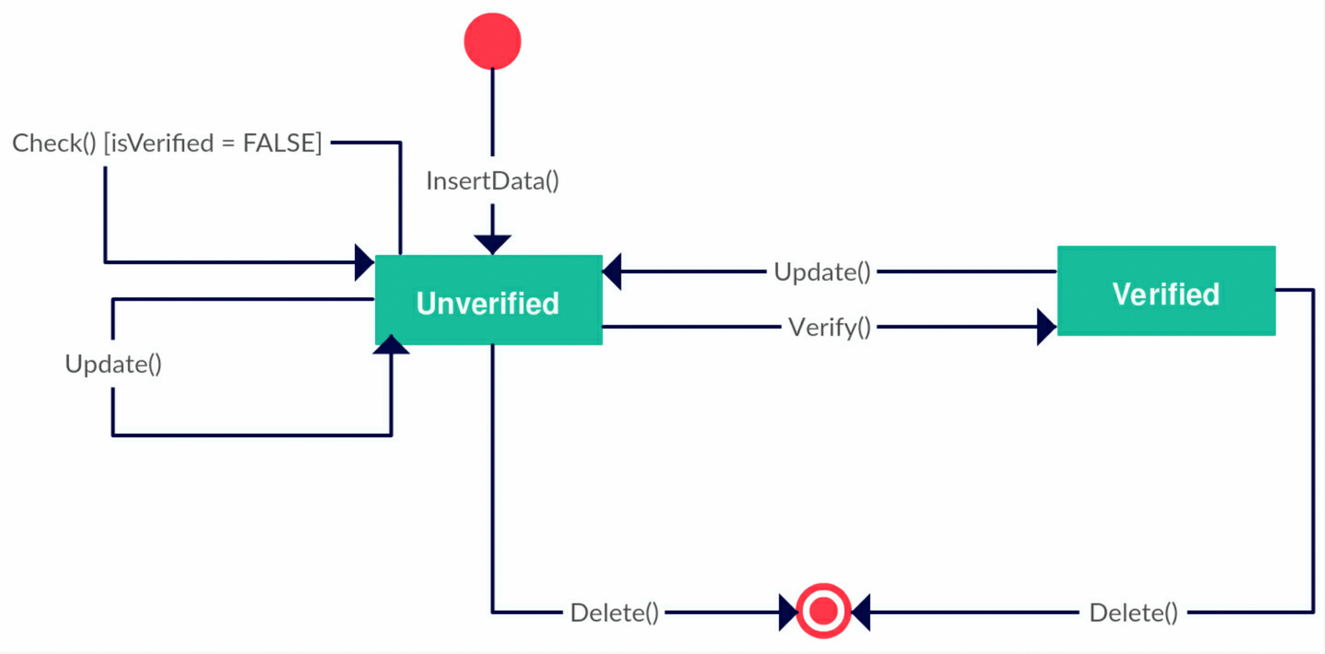
State Diagram for Data Class

Slide 12
State Diagram for Client Class

Slide 13
State Diagram for Service Manager Class

Slide 14
State Diagram for Finance Manager Class

Slide 15
State Diagram for Senior Production Manager Class

Slide 16
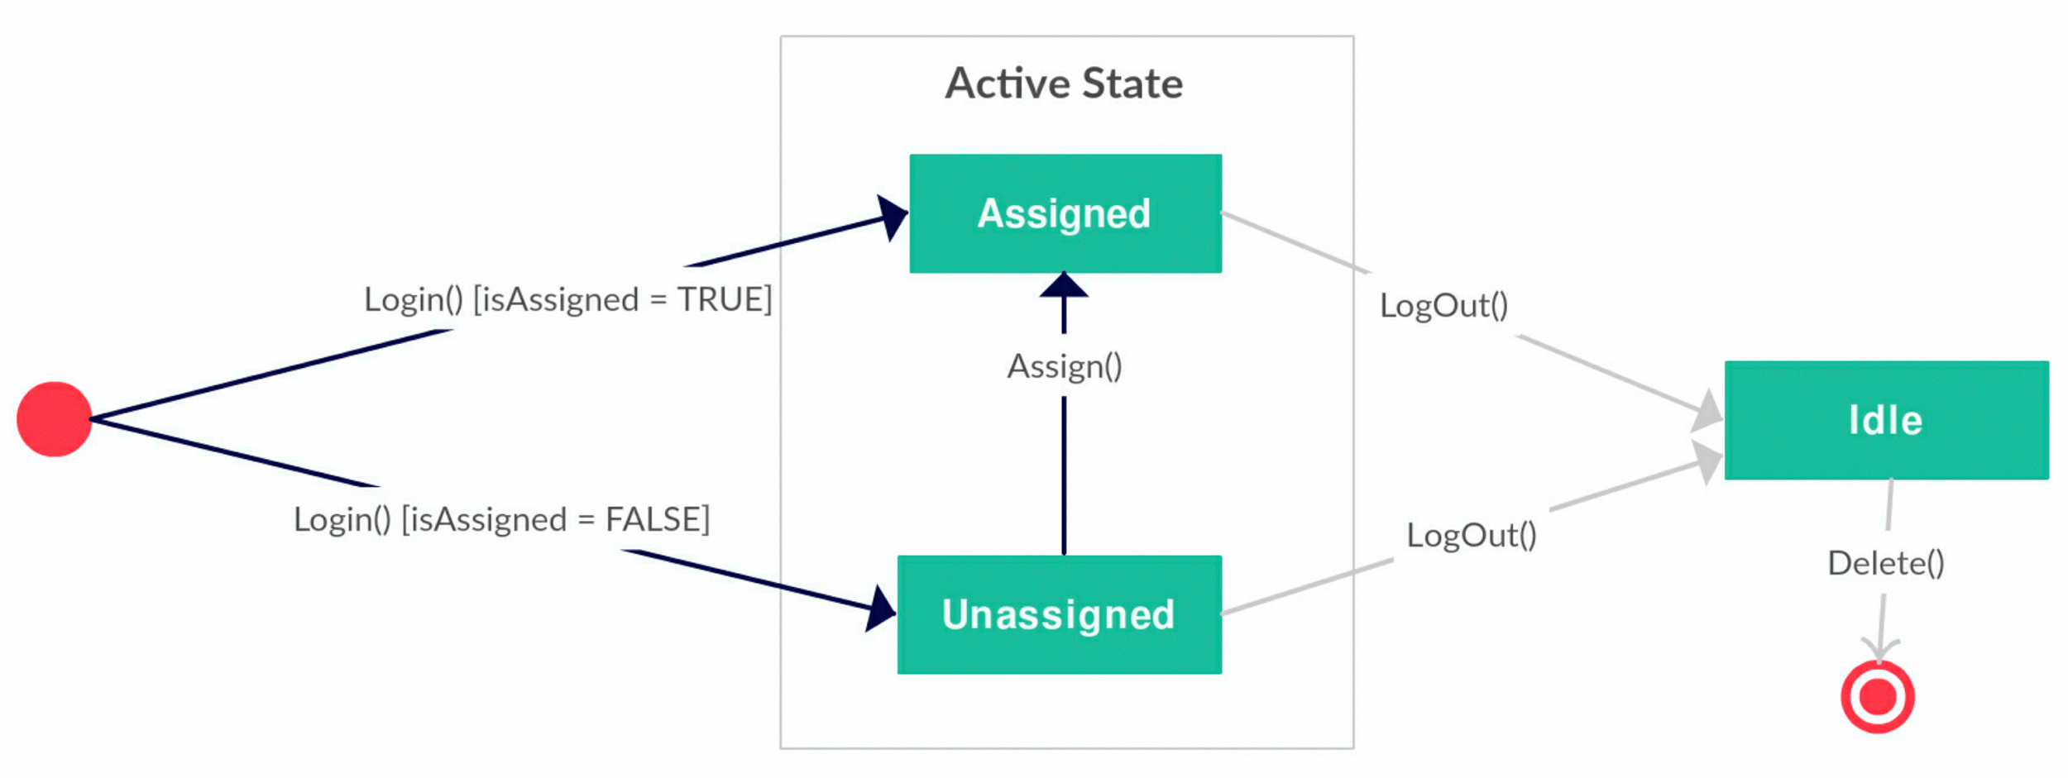
State Diagram for Junior Production Manager Class

Slide 17
Thank you.

